Slide 1
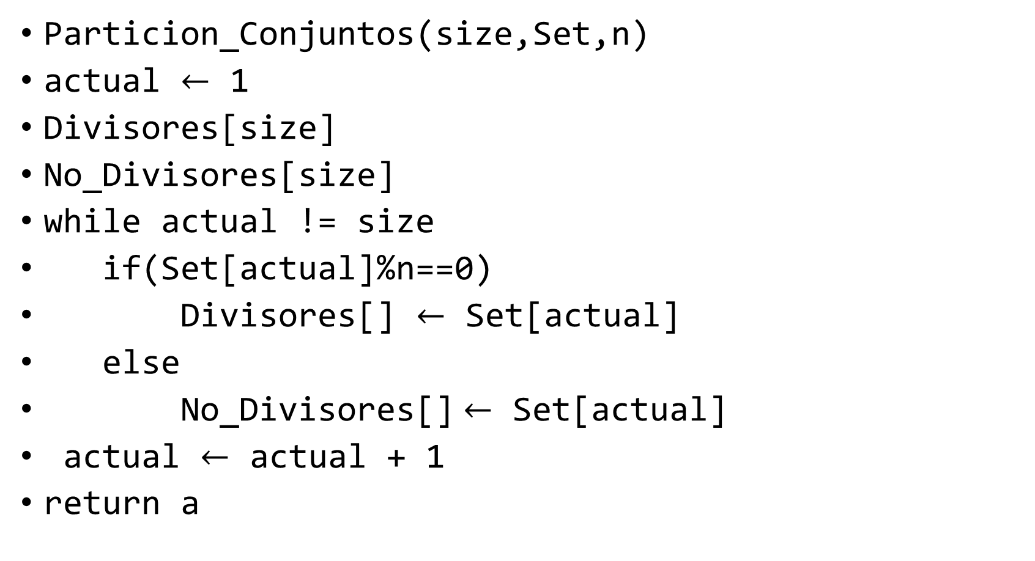
Particion de Conjuntos
Particion_Conjuntos(size,Set,n)
actual $←$ 1
Divisores[size]
No_Divisores[size]
while actual != size
if(Set[actual]%n==0)
Divisores[] $←$ Set[actual]
else
No_Divisores[] $←$ Set[actual]
actual $←$ actual + 1
return a

Slide 2
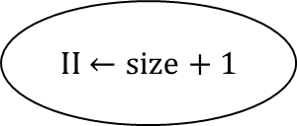

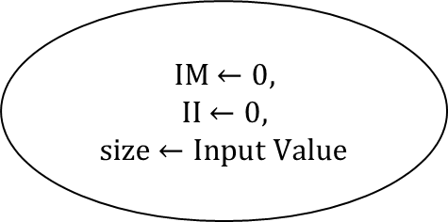

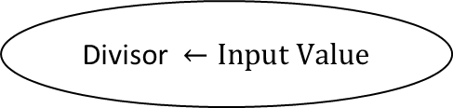


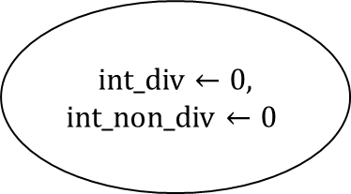

Index Memory – IM
Index Input - II
int_div $←0,$
int_non_div $←0$
IM $←0,$
II $←0,$
size $←Input Value$
start
$$1$$
IDLE
AWAIT
$$0$$
Divisor $←Input Value$
II $←size+1$
AWAIT
II $←1$
AWAIT
AWAIT
II!=size
value $←Input Value$
$$0$$
WHILE
END
1

Slide 3
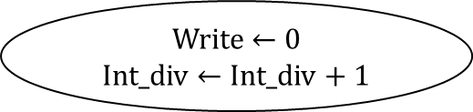
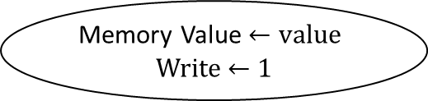



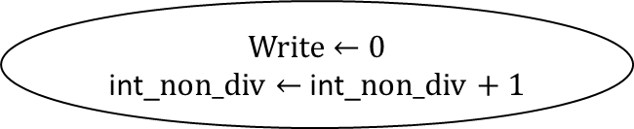




$$1$$
value %Divisor==0
IM $←\text{int}\text{_}\text{non}\text{_}\text{div}\text{ + }\text{size}$
$$0$$
AWAIT
$$1$$
Memory Value $←value$
Write $←$ 1
IM $←\text{int}\text{_}\text{div}$
AWAIT
Write $←$ 0
int_non_div $←$ int_non_div + 1
Memory Value $←value$
Write $←$ 1
II $←$ II + 1
Write $←$ 0
Int_div $←$ Int_div + 1

Slide 4
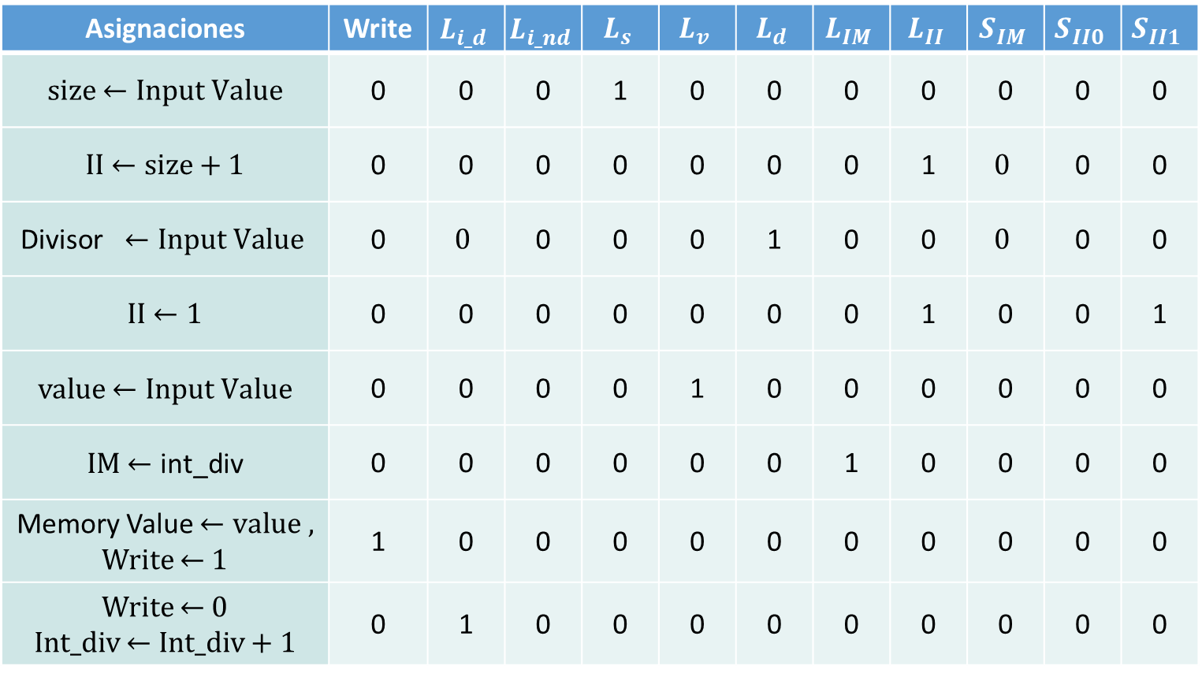
Asignaciones | Write | $$L_{i_d}$$ | $$L_{i_nd}$$ | $$L_{s}$$ | $$L_{v}$$ | $$L_{d}$$ | $$L_{IM}$$ | $$L_{II}$$ | $$S_{IM}$$ | $$S_{II0}$$ | $$S_{II1}$$
size $←Input Value$ | 0 | 0 | 0 | 1 | 0 | 0 | 0 | 0 | 0 | 0 | 0
II $←size+1$ | 0 | 0 | 0 | 0 | 0 | 0 | 0 | 1 | $$0$$ | 0 | 0
$$\text{Divisor} ←Input Value$$ | 0 | $$0$$ | 0 | 0 | 0 | 1 | 0 | 0 | $$0$$ | 0 | 0
II $←1$ | 0 | 0 | 0 | 0 | 0 | 0 | 0 | 1 | 0 | 0 | 1
value $←Input Value$ | 0 | 0 | 0 | 0 | 1 | 0 | 0 | 0 | 0 | 0 | 0
IM $←\text{int}\text{_}\text{div}$ | 0 | 0 | 0 | 0 | 0 | 0 | 1 | 0 | 0 | 0 | 0
Memory Value $←value ,$ Write $←$ 1 | 1 | 0 | 0 | 0 | 0 | 0 | 0 | 0 | 0 | 0 | 0
Write $←$ 0 Int_div $←$ Int_div + 1 | 0 | 1 | 0 | 0 | 0 | 0 | 0 | 0 | 0 | 0 | 0

Slide 5
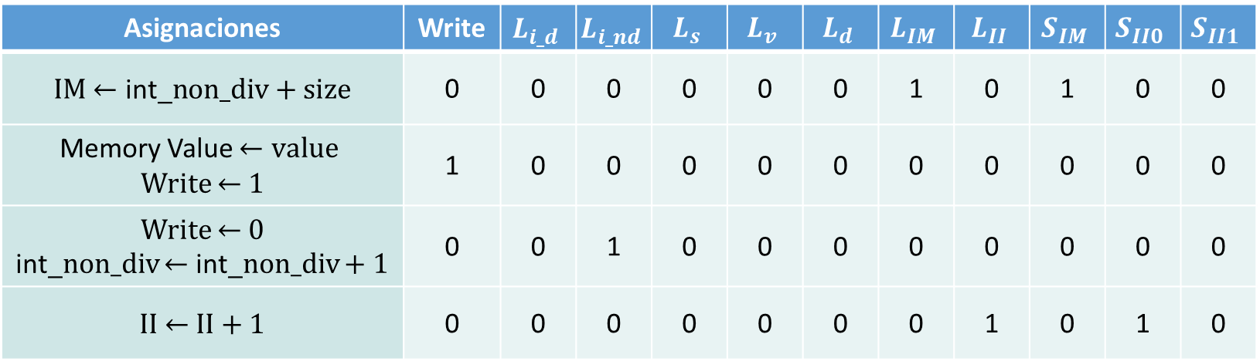
Asignaciones | Write | $$L_{i_d}$$ | $$L_{i_nd}$$ | $$L_{s}$$ | $$L_{v}$$ | $$L_{d}$$ | $$L_{IM}$$ | $$L_{II}$$ | $$S_{IM}$$ | $$S_{II0}$$ | $$S_{II1}$$
IM $←\text{int}\text{_}\text{non}\text{_}\text{div}\text{ + }\text{size}$ | 0 | 0 | 0 | 0 | 0 | 0 | 1 | 0 | 1 | 0 | 0
Memory Value $←value$ Write $←$ 1 | 1 | 0 | 0 | 0 | 0 | 0 | 0 | 0 | 0 | 0 | 0
Write $←$ 0 int_non_div $←$ int_non_div + 1 | 0 | 0 | 1 | 0 | 0 | 0 | 0 | 0 | 0 | 0 | 0
II $←$ II + 1 | 0 | 0 | 0 | 0 | 0 | 0 | 0 | 1 | 0 | 1 | 0

Slide 6

Dados
Dados(n)
a $←$ 6, b $←$ n-1
while b != 0
a $←$ a*6, b $←$ b-1
return a

Slide 7


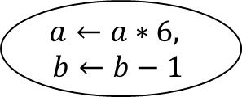


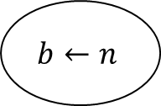

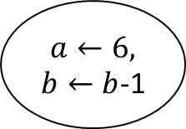

$$1$$
done
$$0$$
start
$$b←n$$
$a←6, b←b$-1
IDLE
$$1$$
AWAIT
WHILE
b$!=0$
$$0$$
END
$$0$$
$$1$$
$$a←a∗6,$$
$$b←b−1$$

Slide 8
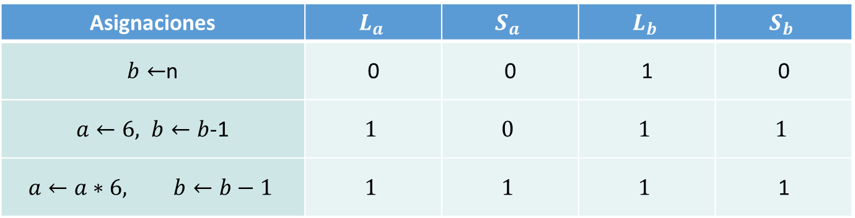
Asignaciones | $$L_{a}$$ | $$S_{a}$$ | $$L_{b}$$ | $$S_{b}$$
$b←$n | 0 | 0 | 1 | 0
$a←6, b←b$-1 | $$1$$ | $$0$$ | $$1$$ | $$1$$
$$a←a∗6, b←b−1$$ | $$1$$ | $$1$$ | $$1$$ | 1

Slide 9
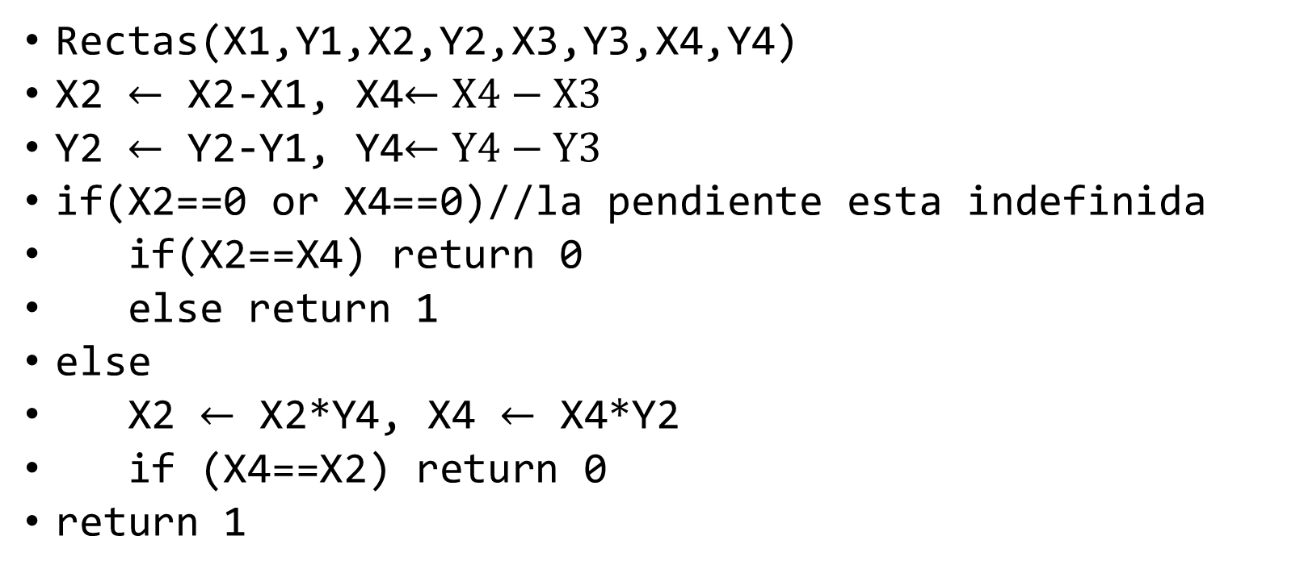
Rectas que se cortan
Rectas(X1,Y1,X2,Y2,X3,Y3,X4,Y4)
X2 $←$ X2-X1, X4$←X4−X3$
Y2 $←$ Y2-Y1, Y4$←Y4−Y3$
if(X2==0 or X4==0)//la pendiente esta indefinida
if(X2==X4) return 0
else return 1
else
X2 $←$ X2*Y4, X4 $←$ X4*Y2
if (X4==X2) return 0
return 1

Slide 10

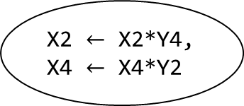




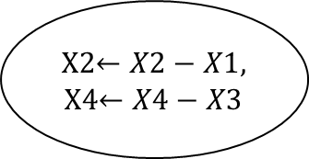


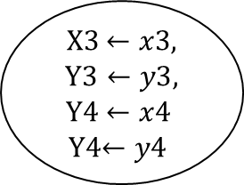


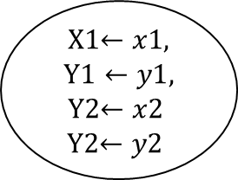
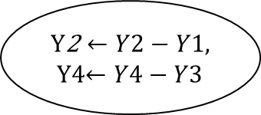

X1$←x1,$
$$\text{Y}\text{1}←y1,$$
Y2$←x2$
Y2$←y2$
X3$←x3,$
$$\text{Y}\text{3}←y3,$$
Y4 $←x4$
Y4$←y4$
X2$←X2−X1,$
X4$←X4−X3$
start
$$1$$
IDLE
$$0$$
X2==0 or
X4==0
$$0$$
$$\text{Y}\text{2}←Y2−Y1,$$
Y4$←Y4−Y3$
X2 $←$ X2*Y4,
X4 $←$ X4*Y2
X2==X4
$$0$$
$$1$$
$$1$$
AWAIT
X2==X4
$$0$$
T $←1$
$$1$$
T $←$0
END

Slide 11
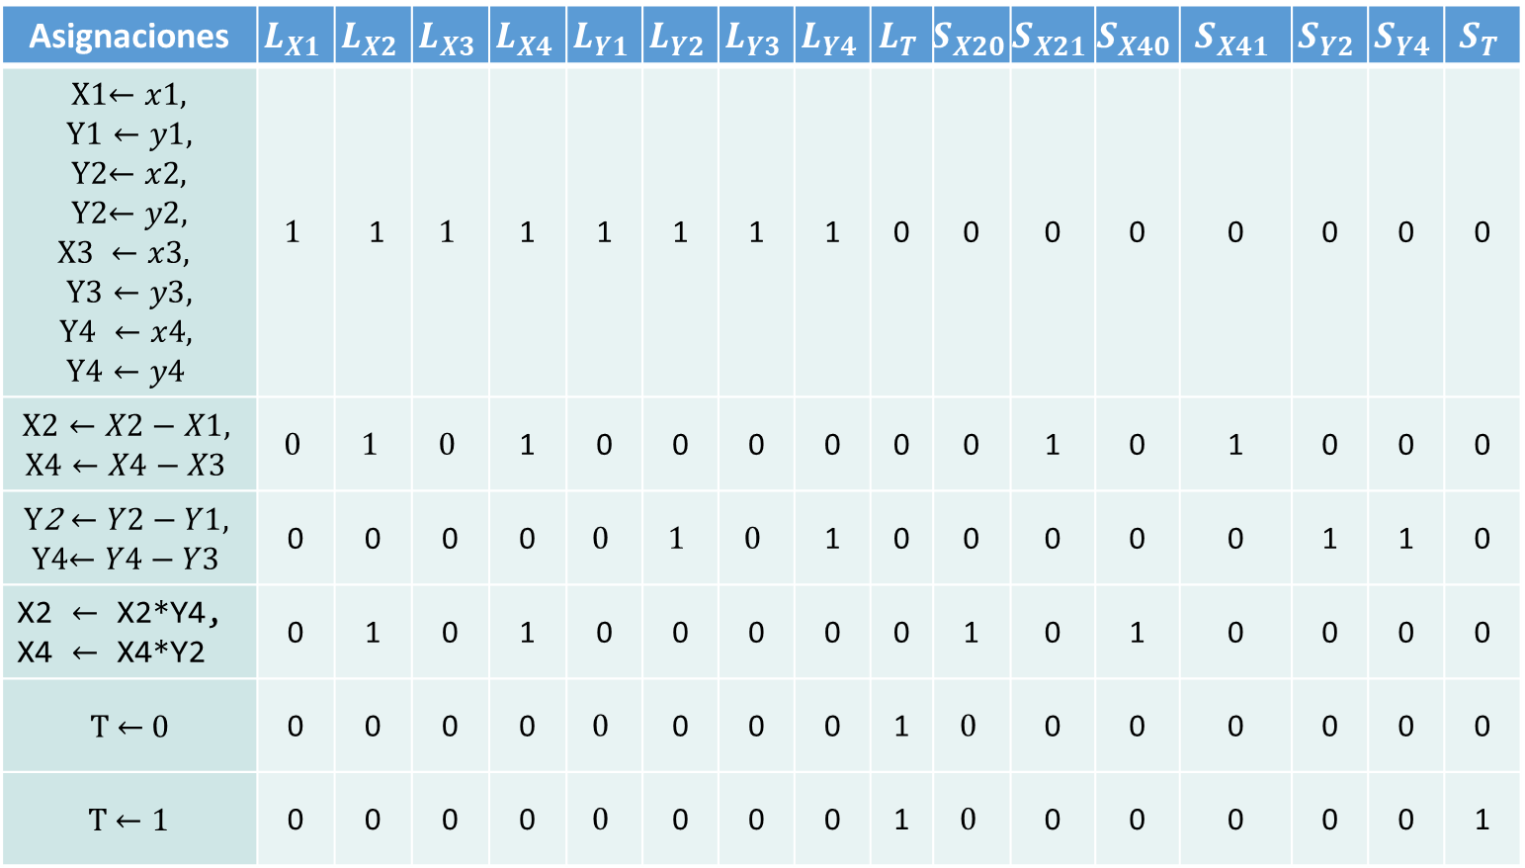
Asignaciones | $$L_{X1}$$ | $$L_{X2}$$ | $$L_{X3}$$ | $$L_{X4}$$ | $$L_{Y1}$$ | $$L_{Y2}$$ | $$L_{Y3}$$ | $$L_{Y4}$$ | $$L_{T}$$ | $$S_{X20}$$ | $$S_{X21}$$ | $$S_{X40}$$ | $$S_{X41}$$ | $$S_{Y2}$$ | $$S_{Y4}$$ | $$S_{T}$$
X1$←x1,$ $\text{Y}\text{1}←y1,$ Y2$←x2,$ Y2$←y2,$ $$\text{X}\text{3} ←x3,$$ $$\text{Y}\text{3}←y3,$$ $$\text{Y}\text{4} ←x4,$$ $$\text{Y}\text{4}←y4$$ | $$1$$ | 1 | $$1$$ | 1 | 1 | 1 | 1 | 1 | 0 | 0 | 0 | 0 | 0 | 0 | 0 | 0
$$\text{X}\text{2}←X2−X1,$$ $$\text{X}\text{4}←X4−X3$$ | $$0$$ | $$1$$ | $$0$$ | 1 | 0 | 0 | 0 | 0 | 0 | 0 | 1 | 0 | 1 | 0 | 0 | 0
$$\text{Y}\text{2}←Y2−Y1,$$ Y4$←Y4−Y3$ | 0 | 0 | 0 | 0 | $$0$$ | $$1$$ | $$0$$ | 1 | 0 | 0 | 0 | 0 | 0 | 1 | 1 | 0
X2 $←$ X2*Y4, X4 $←$ X4*Y2 | 0 | 1 | 0 | 1 | 0 | 0 | 0 | 0 | 0 | 1 | 0 | 1 | 0 | 0 | 0 | 0
T $←$0 | 0 | 0 | 0 | 0 | $$0$$ | 0 | 0 | 0 | 1 | $$0$$ | 0 | 0 | 0 | 0 | 0 | 0
T $←1$ | 0 | 0 | 0 | 0 | $$0$$ | 0 | 0 | 0 | 1 | $$0$$ | 0 | 0 | 0 | 0 | 0 | 1

